Slide 1
Lesson 13
Creating Packages

Slide 2
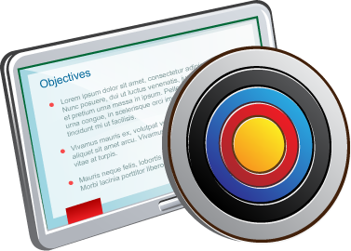
Objectives
After completing this lesson, you should be able to:
  Describe packages and list their components
  Create a package to group together related variables, cursors, constants, exceptions, procedures, and functions
  Designate a package construct as either public or private
  Invoke a package construct
  Describe the use of a bodiless package

Slide 3

Lesson Agenda
  Identifying the benefits and the components of packages
  Working with packages:
    Creating the package specification and body
    Invoking the package subprograms
    Displaying the package information
    Removing a package

Slide 4
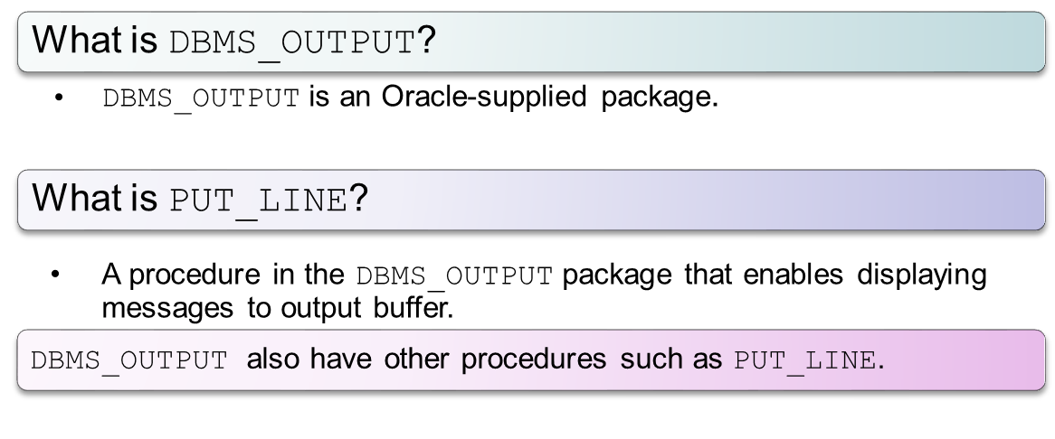
DBMS_OUTPUT.PUT_LINE

Slide 5
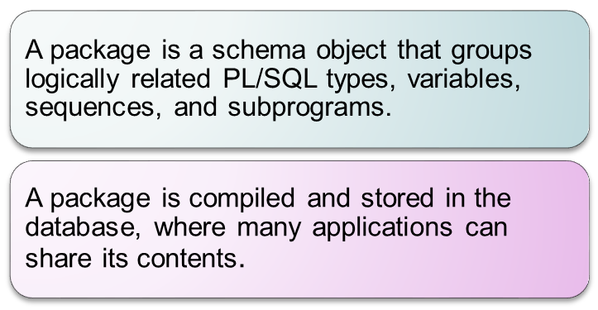
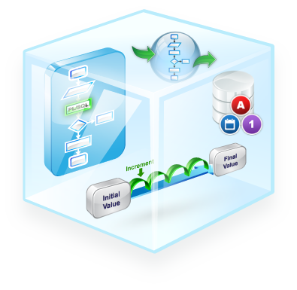
What Is a Package?

Slide 6







Advantages of Packages
Easier application design
Easy maintenance
Better performance
Modularity
Information hiding

Slide 7
How Do You Create PL/SQL Packages?
  Packages usually have two parts:
    A specification (spec)
    A body
  The specification is the interface to the package.
  The body has the implementation.

Slide 8


Components of a PL/SQL Package
variable
Package
specification
Public
Procedure A declaration;
variable initialized
Package
body
Procedure B definition
…
Private
Procedure A definition
BEGIN
…
END;
variable

Slide 9


Application Program Interface
Package
Public Components
Private Components
API
A developer can access the functionality of a package through the Application Program Interface (API) of the package.

Slide 10
Lesson Agenda
  Identifying the benefits and the components of packages
  Working with packages:
    Creating the package specification and body
    Invoking the package subprograms
    Displaying the package information
    Removing a package

Slide 11

Creating the Package Specification:
Using the CREATE PACKAGE Statement
CREATE [OR REPLACE] PACKAGE package_name IS|AS
public type and variable declarations
subprogram specifications
END [package_name];

Slide 12


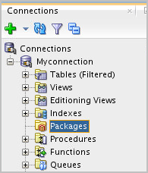


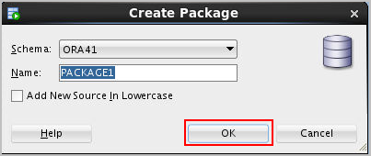
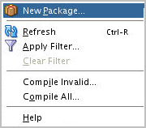

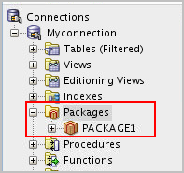
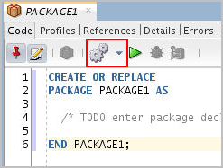



Creating Package Specification: Using SQL Developer
1
2
Provide the package name in the wizard.
Right-click Packages in the Connections tab and select New Package.
4
3
Add declarations to the specification and compile it.
On successful compilation, package specification is created in the Connections tab and you can also see Compiled message in the Messages tab.

Slide 13



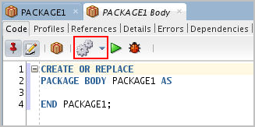

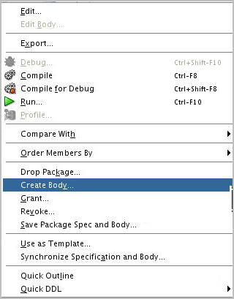

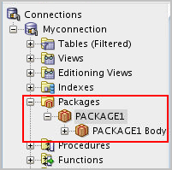
Creating the Package Body: Using SQL Developer
Right-click the Package created and select Create Body.
2
Add procedure and function definitions to the package and compile it.
1
On successful compilation, package body is created in the Connections tab and you can also see Compiled message in the Messages tab.
3

Slide 14

Example of a Package Specification: comm_pkg
-- The package spec with a public variable and a
-- public procedure that are accessible from
-- outside the package.
CREATE OR REPLACE PACKAGE comm_pkg IS
v_std_comm NUMBER := 0.10; --initialized to 0.10
PROCEDURE reset_comm(p_new_comm NUMBER);
END comm_pkg;
/
  v_std_comm is a public global variable initialized to 0.10.
  reset_comm is a public procedure used to reset the standard commission based on some business rules. It is implemented in the package body.

Slide 15

Creating the Package Body
CREATE [OR REPLACE] PACKAGE BODY package_name IS|AS
private type and variable declarations
subprogram bodies
[BEGIN initialization statements]
END [package_name];
  The OR REPLACE option drops and re-creates the package body.
  Identifiers defined in the package body are private and not visible outside the package body.
  All private constructs must be declared before they are referenced.
  Public constructs are visible to the package body.

Slide 16

Example of a Package Body: comm_pkg
CREATE OR REPLACE PACKAGE BODY comm_pkg IS
FUNCTION validate(p_comm NUMBER) RETURN BOOLEAN IS
v_max_comm employees.commission_pct%type;
BEGIN
SELECT MAX(commission_pct) INTO v_max_comm
FROM employees;
RETURN (p_comm BETWEEN 0.0 AND v_max_comm);
END validate;
PROCEDURE reset_comm(p_new_comm NUMBER) IS
BEGIN
IF validate(p_new_comm) THEN
v_std_comm := p_new_comm; -- reset public var
ELSE RAISE_APPLICATION_ERROR(
-20210, 'Bad Commission');
END IF;
END reset_comm;
END comm_pkg;

Slide 17



Invoking the Package Subprograms: Examples
-- Invoke a function within the same packages:
CREATE OR REPLACE PACKAGE BODY comm_pkg IS ...
PROCEDURE reset_comm(p_new_comm NUMBER) IS
BEGIN
IF validate(p_new_comm) THEN
...
END IF;
END reset_comm;
END comm_pkg;
-- Invoke a package procedure from SQL*Plus:
EXECUTE comm_pkg.reset_comm(0.15)
-- Invoke a package procedure in a different schema:
EXECUTE scott.comm_pkg.reset_comm(0.15)

Slide 18

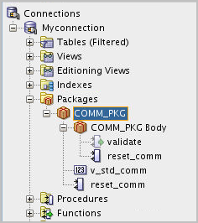

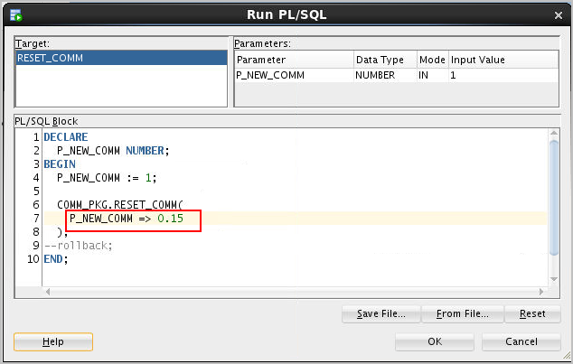
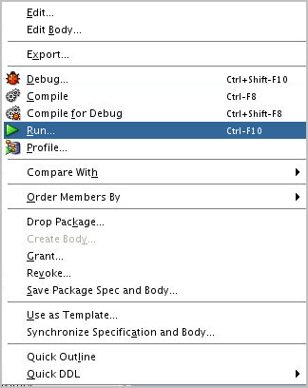
Invoking Package Subprograms: Using SQL Developer
1
2

Slide 19



Creating and Using Bodiless Packages
CREATE OR REPLACE PACKAGE global_consts IS
c_mile_2_kilo CONSTANT NUMBER := 1.6093;
c_kilo_2_mile CONSTANT NUMBER := 0.6214;
c_yard_2_meter CONSTANT NUMBER := 0.9144;
c_meter_2_yard CONSTANT NUMBER := 1.0936;
END global_consts;
SET SERVEROUTPUT ON
BEGIN
DBMS_OUTPUT.PUT_LINE('20 miles = ' ||
20 * global_consts.c_mile_2_kilo || ' km');
END;
SET SERVEROUTPUT ON
CREATE FUNCTION mtr2yrd(p_m NUMBER) RETURN NUMBER IS
BEGIN
RETURN (p_m * global_consts.c_meter_2_yard);
END mtr2yrd;
/
EXECUTE DBMS_OUTPUT.PUT_LINE(mtr2yrd(1))

Slide 20

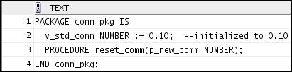

Viewing Packages by Using the Data Dictionary
-- View the package specification.
SELECT text
FROM user_source
WHERE name = 'COMM_PKG' AND type = 'PACKAGE'
ORDER BY LINE;
-- View the package specification.
SELECT text
FROM user_source
WHERE name = 'COMM_PKG' AND type = 'PACKAGE'
ORDER BY LINE;

Slide 21
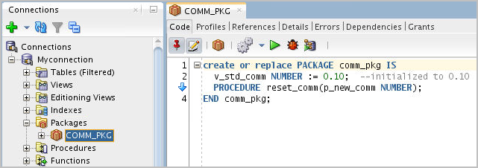

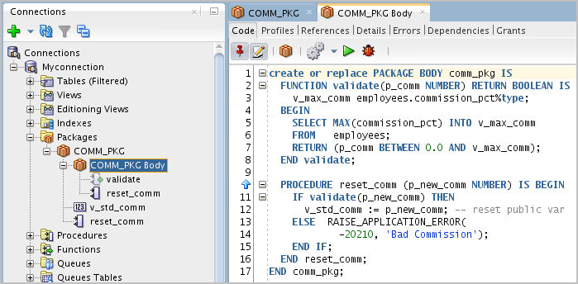

Viewing Packages by Using SQL Developer
2
1
To view the package spec, click the package name.
Value
Unique key column
Unique key column
Unique key column
Unique key column
2
To view the package body, click the package body.

Slide 22
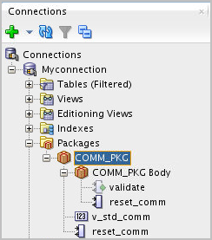
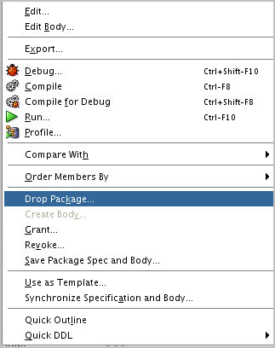

Removing Package
Drop the package specification and body.
DROP PACKAGE package_name;

Slide 23
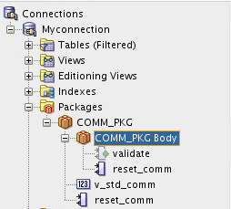

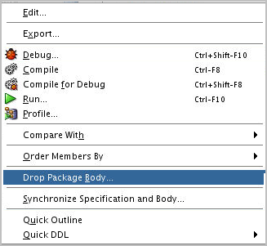
Removing Package Bodies
Drop only the package body.
DROP PACKAGE BODY package_name;

Slide 24
Guidelines for Writing Packages
  Develop packages for general use.
  Define the package specification before the body.
  The package specification should contain only those constructs that you want to be public.
  Place items in the declaration part of the package body when you must maintain them throughout a session or across transactions.
  The package specification should contain as few constructs as possible.

Slide 25

Quiz
The package specification is the interface to your applications. It declares the public types, variables, constants, exceptions, cursors, and subprograms available for use. The package specification may also include PRAGMAs, which are directives to the compiler.
  True
  False

Slide 26
Summary
In this lesson, you should have learned how to:
  Describe packages and list their components
  Create a package to group related variables, cursors, constants, exceptions, procedures, and functions
  Designate a package construct as either public or private
  Invoke a package construct
  Describe the use of a bodiless package

